Slide 1

TSI MPTT project REPORT
BHAVYA SHASHIDHAR
Notes:
Self introduction

Slide 2
agenda
Introduction
Business Problem
Solution Design
KPI Overview
Student Insights
Programme Insights
Employee Insights
Summary
Technology Recommendation
Data Quality
Future Challenges
Q&A?
Notes:
Go through agenda

Slide 3

Introduction
Bhavya Shashidhar

Slide 4
Business Problem
Student Intake
Programme Success
Jobs with Dignity
Employer Engagement
Notes:
Whats current situation of student intake, any chance to improve.
What’s the most popular and successful program. How to improve program success.
How many jobs have we achieved and whats current employment situation. Any opportunity to get more jobs and higher salary.
How many employer do we have and how many they hired from us.

Slide 5


Solution Design
students
employers
programmes
employment
Notes:
We got data from MPTT who got original data from providers in excel sheets. We extract four dimentions from source data which are students, programmes, employment and employers. With Power BI, we managed to get some dashboards figuring out what’s the story behind the data.

Slide 6
KPI Overview
Total students
Total Programmes
Total Employees
654
18
105
Data collected from 2016-2019

Slide 7
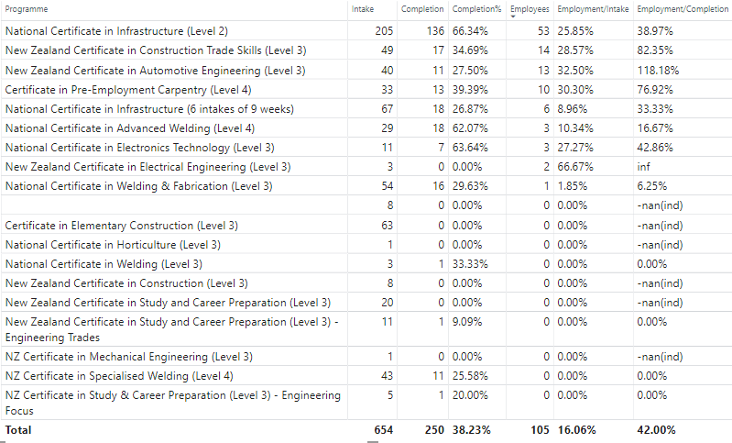

KPI Overview

Slide 8
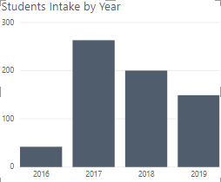
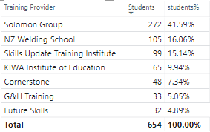
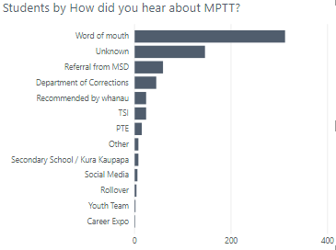
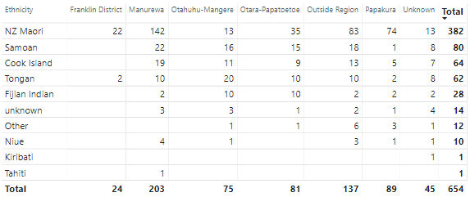
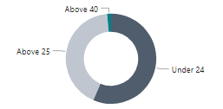
Marketing
Student Insights
70%
382
:
272
Notes:
We had a sharp increase from 2016 and slowly decreased from 2017. the three providers contributes 70% students intake.
Maori and pacific had 382 and 272 students.
we can see that most of the students heard our project from other people. We can think of dong more marketing o let people know us from more channels. This should be on solution for us.
Let’s look at more details about students .( go to dashboard).
Any questions about students part?
Let’s look at what’s the story of programmes. Bhavya will explain this part.

Slide 9
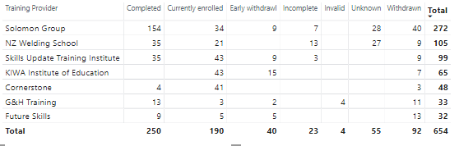
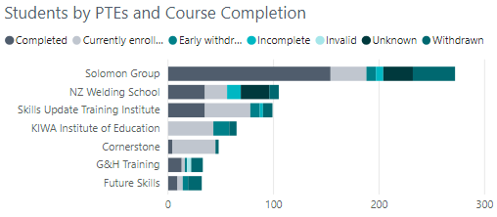
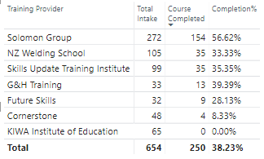
Reasons, challenges
Programme Insights – by PTEs
data update
Notes:
We can mentioned

Slide 10
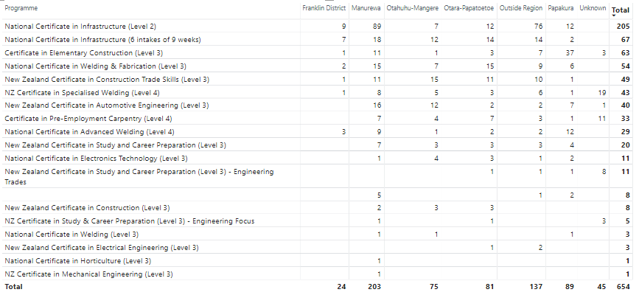
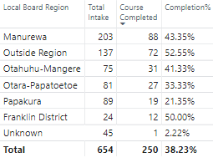
Programme Insights – by Local Board Regions
Challenges, resources

Slide 11
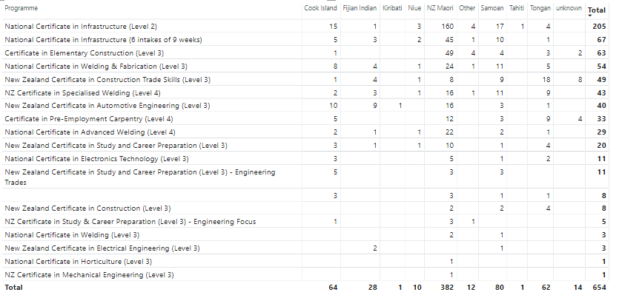
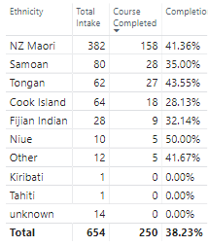
Reasons, challenges
Programme Insights – by Ethnicity

Slide 12
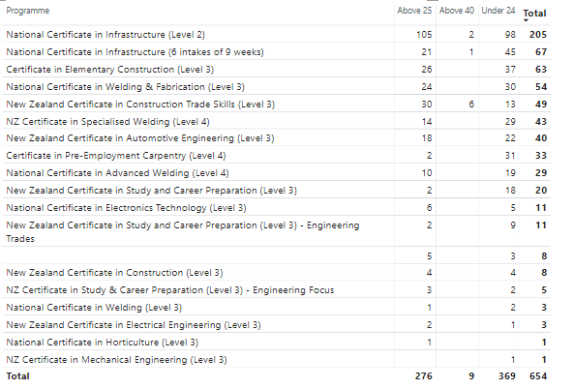
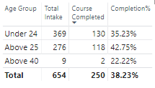
Reasons, challenges
Programme Insights – by Age Group

Slide 13
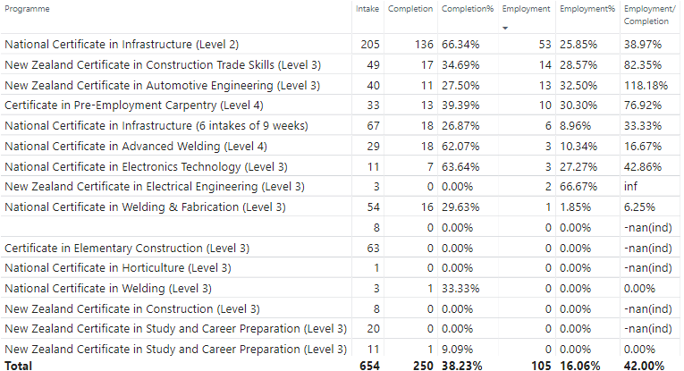
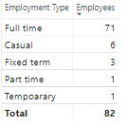
Employment Insights – by programmes

Slide 14
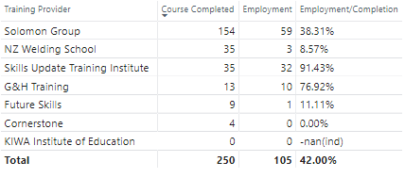
Employment Insights – by providers
16 employers signed but positions depends on demands.

Slide 15
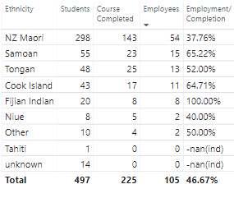
Employment Insights – by Ethnicity

Slide 16
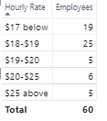
Employment Insights – by Start Rate

Slide 17
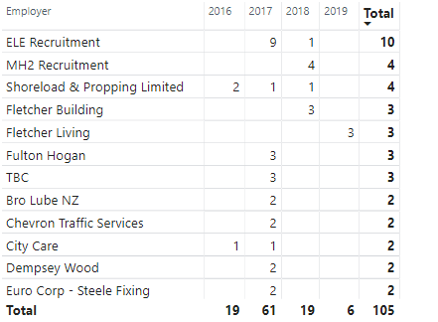
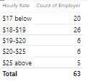
Employment Insights – by employers
Total Employers
78
Notes:
We have 78 employers shown in dataset among whom top 10 employers are in the list.
26 employers hired people with $18-$19 per hour. We also have some employers provide great wage.

Slide 18
Marketing, Providers
Summary
Student Intake
Providers, Ethnicity, Programmes
Programme Success
Programmes, Providers, Ethnicity
Jobs with Dignity
Employers number, jobs number, living wage
Employer Engagement

Slide 19




Technical Recommendation
Data Warehouse
Reporting Solution
On premise solution
Power BI pro licenses
Cloud based solution
Notes:
a. Data Warehouse - Cost Benefit Analysis to be performed to make a decision between
1. On Premise solution (using Microsoft SSIS for ETL, SQL Server 2019, Power BI)
OR
2. Cloud based solution (such as using Azure Data Factory, Azure Data Lake Storage, Azure Synapse Analytics, Power BI)
b. Reporting Solution - Auckland Council should get Power BI pro licenses. Using which they can create Workspace, deploy the Power BI files and collaborate across multiple users

Slide 20
Data Quality
Data Missing
Data Clean
Database
Notes:
Data missing, lost some of the data such as drug issue, Iwi type, employment status, salary, programme completion status etc.
Data clean means data structure, data format, data definition for example local board region, how did you hear about MPTT etc.
Database will be more structured data with logic check which will be very helpful for data qualiy.

Slide 21
Future Challenges
Conviction
Drug issue
Financial problem
Family issue
Notes:
a. Data Warehouse - Cost Benefit Analysis to be performed to make a decision between
1. On Premise solution (using Microsoft SSIS for ETL, SQL Server 2019, Power BI)
OR
2. Cloud based solution (such as using Azure Data Factory, Azure Data Lake Storage, Azure Synapse Analytics, Power BI)
b. Reporting Solution - Auckland Council should get Power BI pro licenses. Using which they can create Workspace, deploy the Power BI files and collaborate across multiple users

Slide 22
Q & A
Notes:
a. Data Warehouse - Cost Benefit Analysis to be performed to make a decision between
1. On Premise solution (using Microsoft SSIS for ETL, SQL Server 2019, Power BI)
OR
2. Cloud based solution (such as using Azure Data Factory, Azure Data Lake Storage, Azure Synapse Analytics, Power BI)
b. Reporting Solution - Auckland Council should get Power BI pro licenses. Using which they can create Workspace, deploy the Power BI files and collaborate across multiple users

Slide 23
Thank you!

